Slide 1
Picking time estimation

Slide 2
Objective
Given the picking time of each object by specific user and other variables find out the picking time

Slide 3
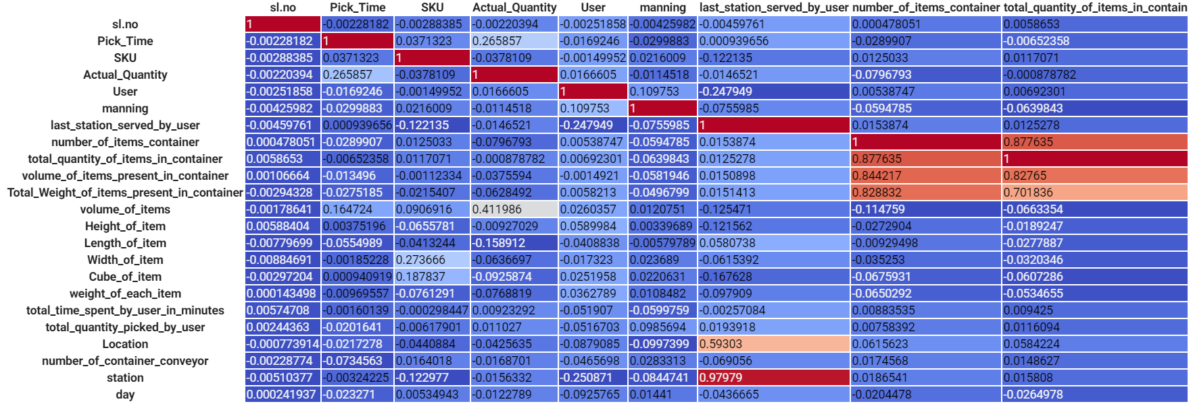
Correlation

Slide 4
Procedure
Pick the attributes that contribute to a high/low correlation with the “Pick_Time”
One-hot encode categorical data such as “Users” and “Location”
Split the training data in the ratio of 80:20 for training and test datasets
Plot all the attribute vs attribute and vs “Pick_Time”

Slide 5
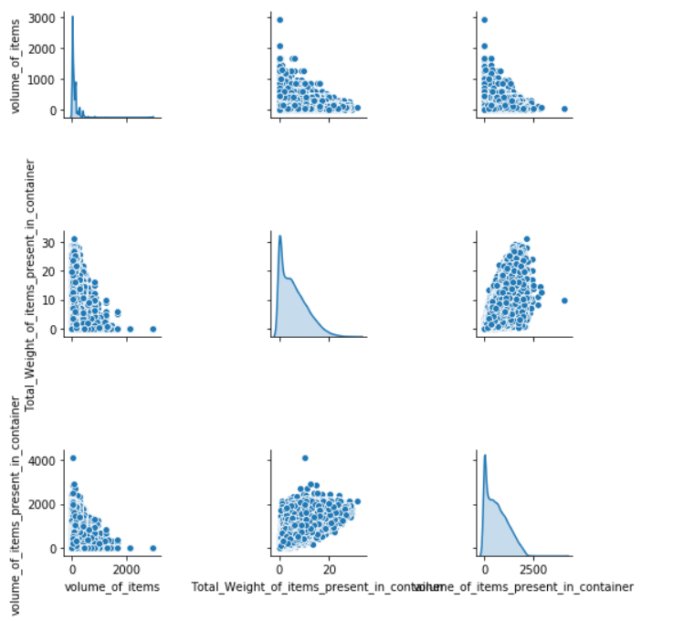

Slide 6
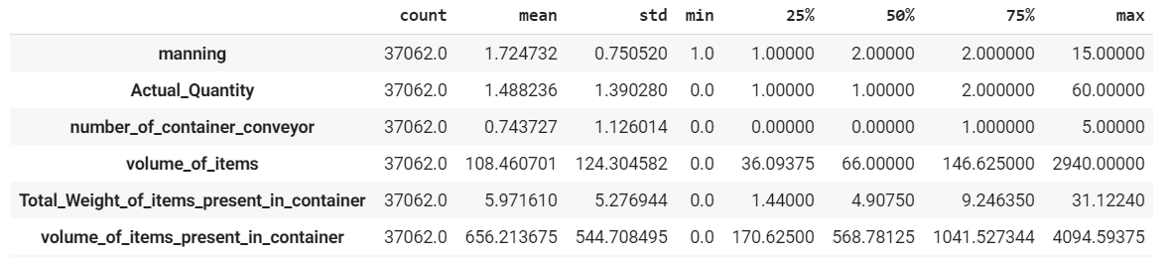
Stats about the given data
Training data

Slide 7
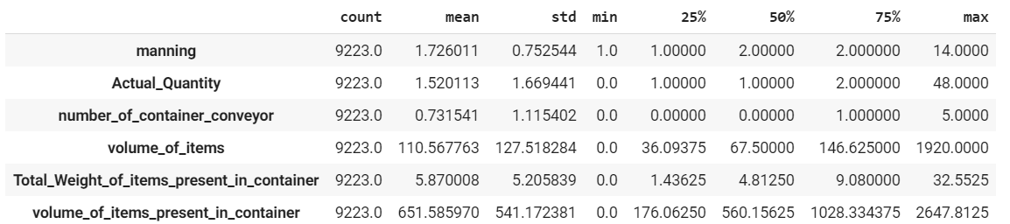
Stats about the given data
Test data

Slide 8
Model
Neural network consisting of the following layers:
Dense(64), activation = relu
BatchNormalization
Dense(16), activation = relu
BatchNormalization
Dense(4), activation = relu
BatchNormalization
Dense(1), activation = linear

Slide 9
Model
Loss: mean squared error
Optimizer: RMSprop (learning_rate = 0.0001)
Epochs: 100 (EarlyStopping callback included)
Batch_size = 32

Slide 10
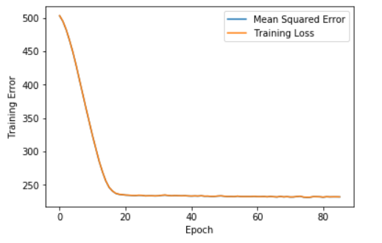
Learning curve

Slide 11
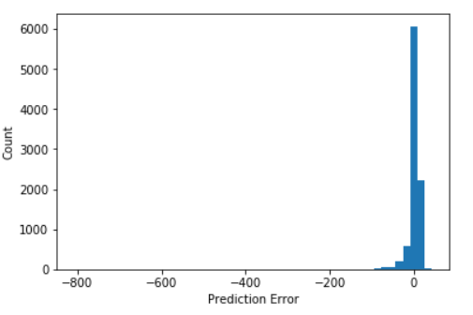
Prediction error histogram

Slide 12
Thank you!

